Slide 1
DevOps Pipeline
Presented By:
Abhishek Bandarpule
Calvin Fernando
Davis Pynadath
Revanth Pathuri

Slide 2
Goal
Milestone 1
Milestone 2
Milestone 3
Special Milestone
Configuration Management and Build
Test & Analysis
Deployment & Infrastructure Upgrade
Feasibility of App-Migration

Slide 3
Milestone 1 - Build Stage
Configuration Management & Build
Jenkins Server Setup
Build Jobs
iTrust (Java Application)
Checkbox.io (Node Application)
3. Local Deploy

Slide 4
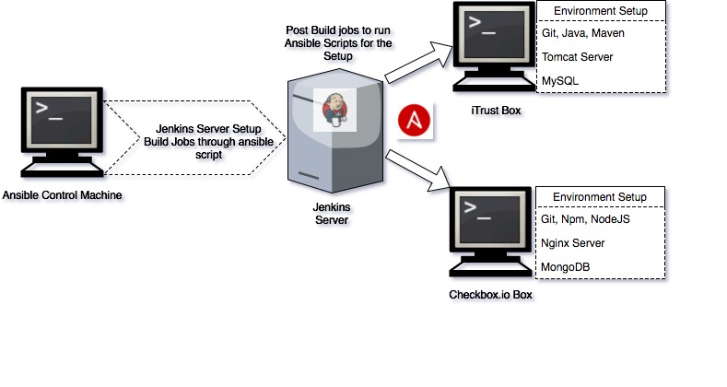
Milestone 1

Slide 5
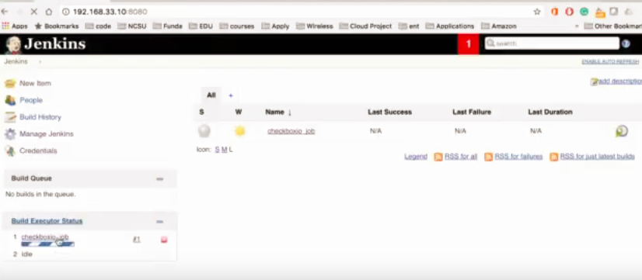
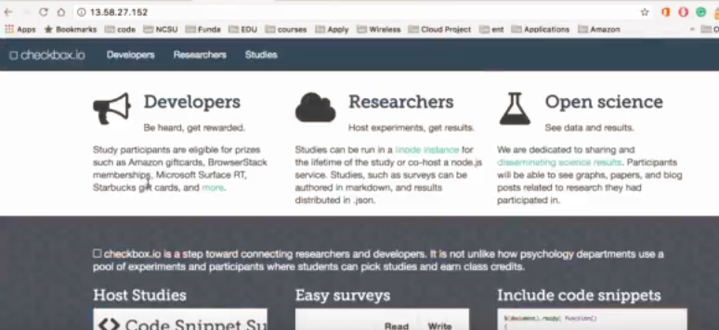
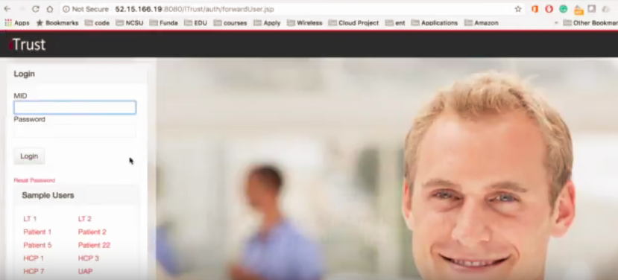
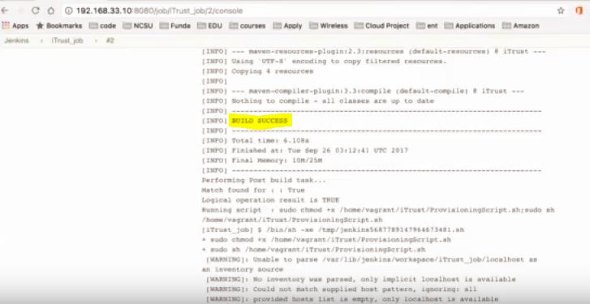
Milestone 1
Checkbox.io App
Jenkins Server
Build Log
iTrust App

Slide 6
Milestone 2 - Test and Analysis
Fuzzing and Useless Test Case detector
Code Coverage Report
Code Analysis

Slide 7
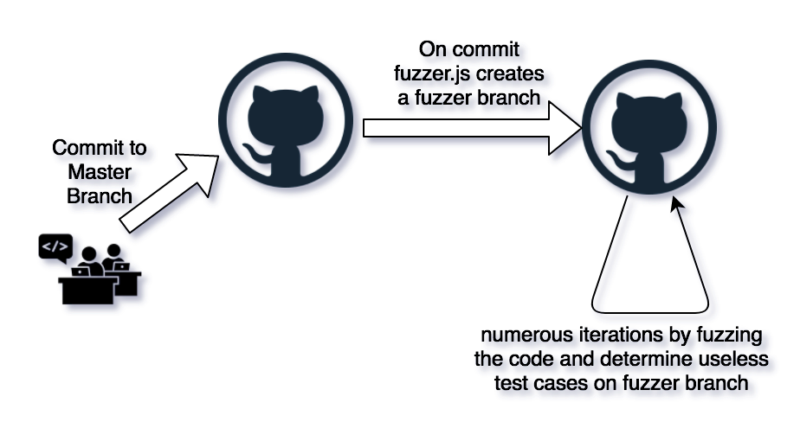
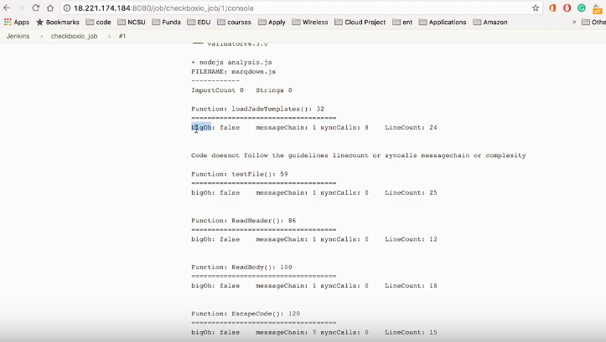
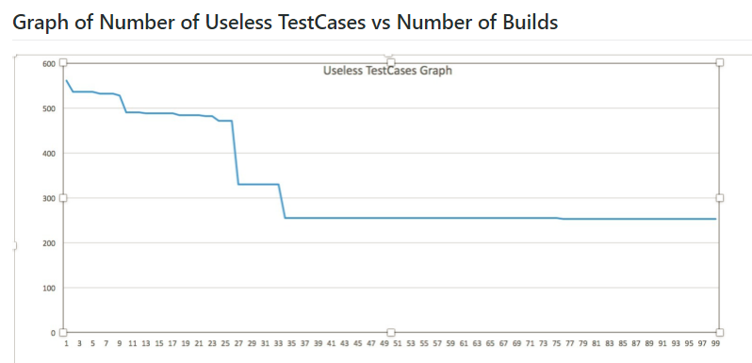
Milestone 2 (Testing & Analysis)
Build Log for Code analysis on checkbox.io application

Slide 8
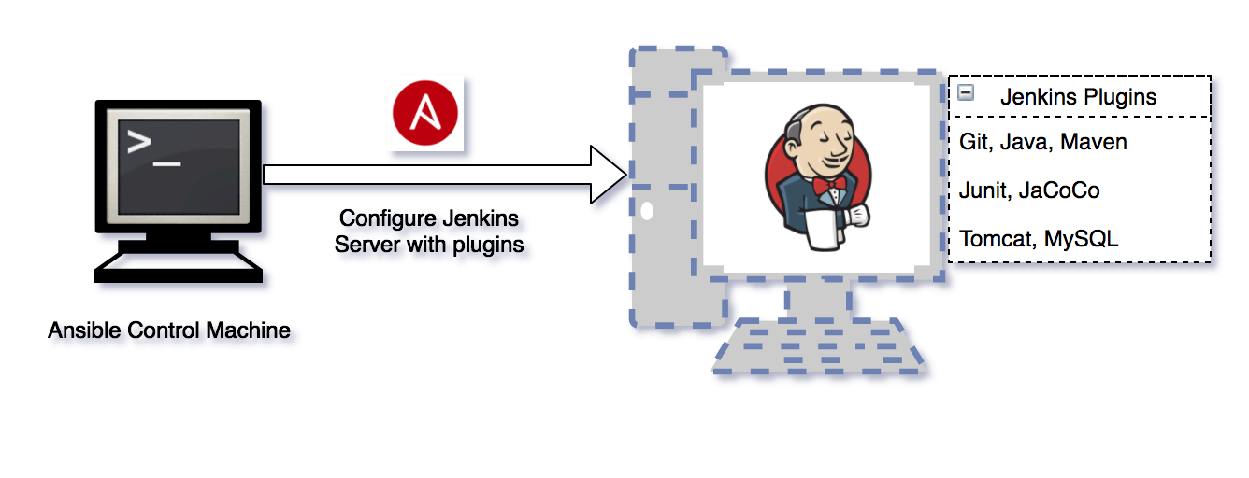
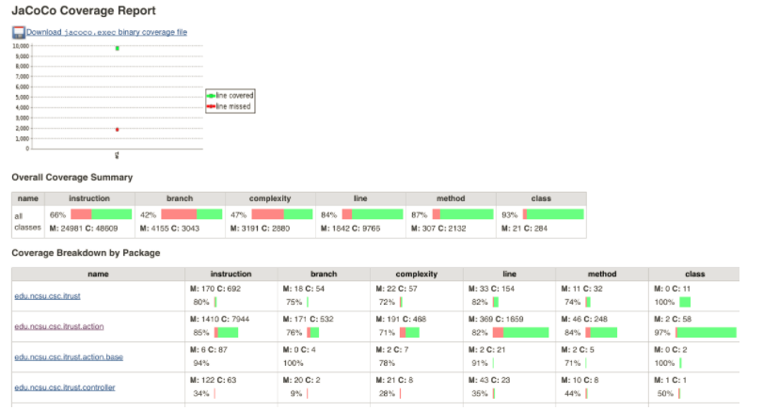
Milestone 2 (Code Coverage Report)
Jenkins Server Code Coverage

Slide 9
Milestone 3 - Deploy Stage
Deployment
Remote deployment to EC2
Infrastructure Upgrades
Nomad Cluster
Feature Flag
3. Canary Release
4. Rolling Update

Slide 10
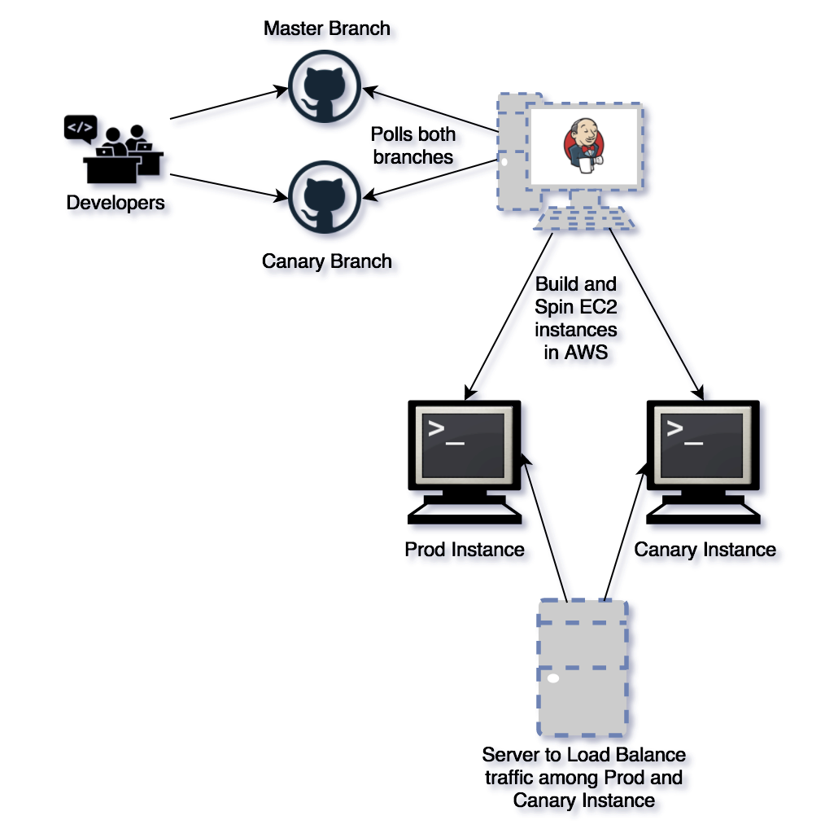
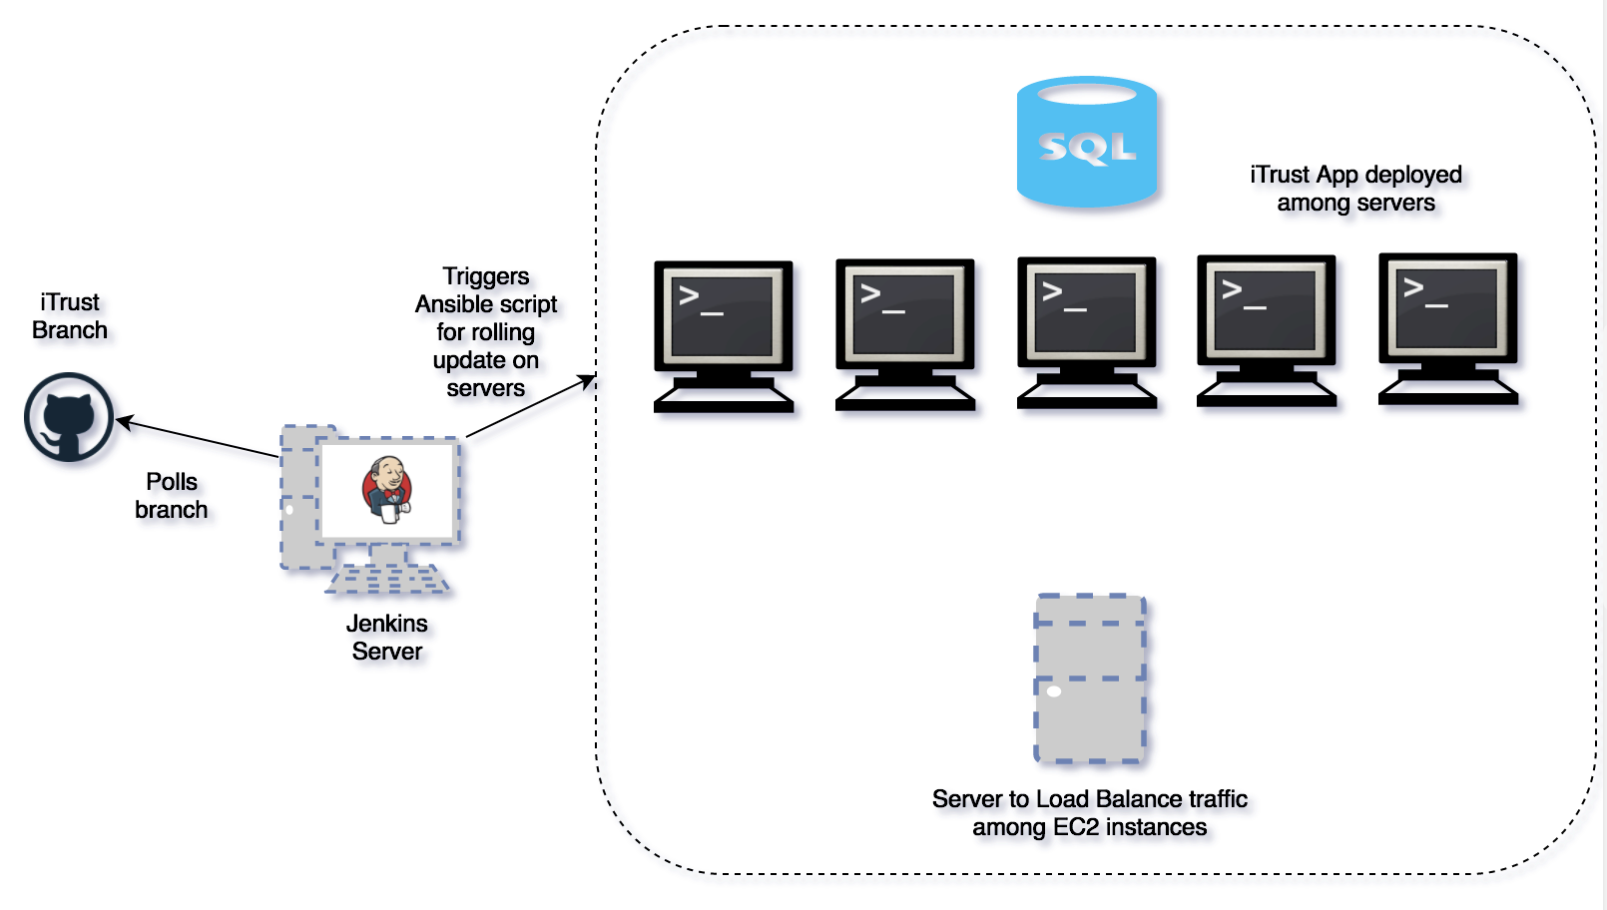
Milestone 3
Canary Release
Rolling Update

Slide 11
Special Milestone
Feasibility of App-Migration to Cloud
Why?
Aid customers in tackling the factors that inhibit the migration to cloud.
Effective utilisation of cloud resources and services
Bang for the buck
Choosing the right provider

Slide 12
Analysis on Cloudifying Application
How?
Compliance
Compute
Storage
Network
Security
Architecture
License
Dependencies

Slide 13
Thank You!! :)

